Slide 1

ViroAlert
What is the Next Pandemic?

Slide 2


ABOUT US
ViroAlert Team
Iman Ibrahim
Yousef Osama
Nesma Abd-ElKader
Sara Gamal
Supervised By
Dr. AbdElMoniem Bayoumi
Virology Expert
Dr. Ebrahim Hassan (Nile University)

Slide 3
01
02
03
04
Intoduction
System Flow
Virus Host Adaptability Predictor(ML)
Virus Host Adaptability Predictor(DL)
05
06
07
Drug-Target Interaction Predictor
Drug Generator
Demo

Slide 4


01
Introduction

Slide 5
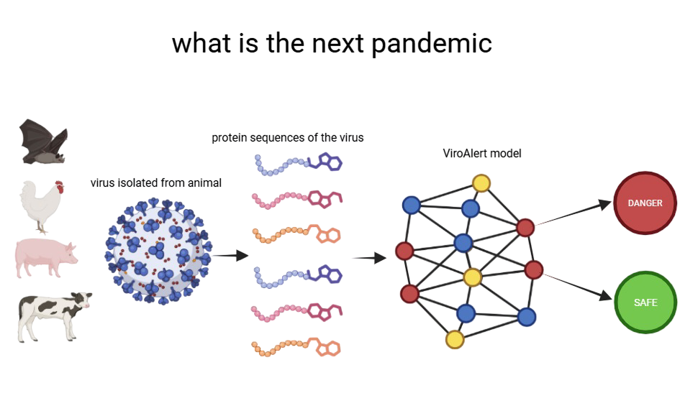
What if we could spot Viruses like COVID-19 before they spread ?
ViroAlert is an AI tool that predicts if a virus can infect humans.
Giving health experts a dynamic early warning to act fast and save lives.

Slide 6
Can today’s drugs block tomorrow’s virus?
ViroAlert Searches for any drug that can disable the threat before it spreads.
What if there is no cure?
ViroAlert doesn’t just search for cures it invents them.

Slide 7
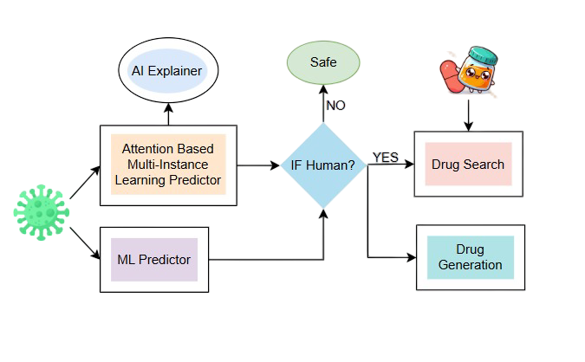

System Flow

Slide 8
Understanding Virus
Viruses store their genetic material as sequences of translated amino acid sequences.
These sequences are written as strings of letters.
Each letter stands for one of the 20 standard amino acids.
🔠 Example viral protein sequence: MKTIIALSYIFCLVFADYKDDDDK

Slide 9
03
Virus Host Adaptability Predictor(ML)

Slide 10
Machine Learning Approaches
NLP
Spaced K-mers
MFV (Minimzer Feature Vector)
Position Weight Matrix (PWM2Vec)
Position Specific Weight Matrix (PSWM2Vec)
Virus2Vec
Biological Features

Slide 11
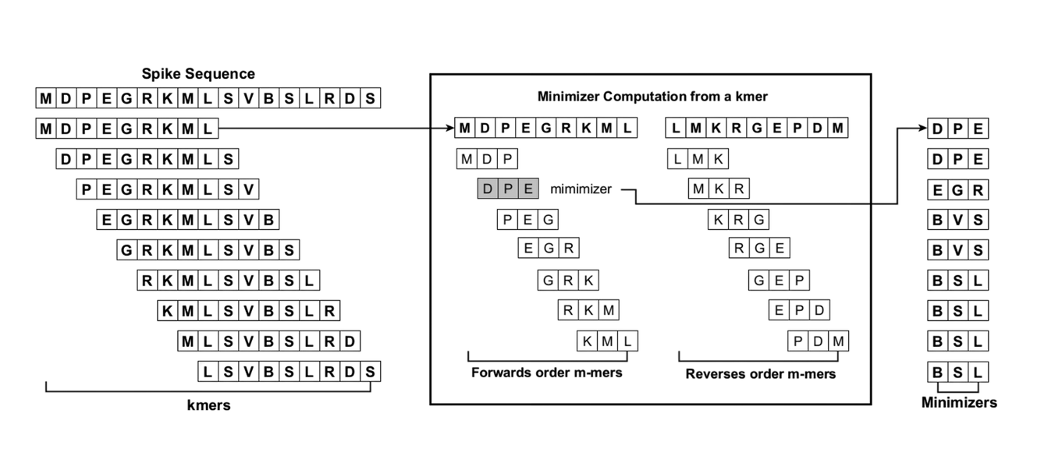
K-mer and Minimizers
K-mer
A continuous substring of length k from a sequence.
Extracted by sliding a window of size k.
Minimzer
The smallest lexicographical m-mer (alphabetical order) found in both the forward and reverse k-mer where (m<k).

Slide 12
Spaced K-mers
Break it into overlapping k-mers.
Count how often each unique kmer appears in the sequence.
❌ Problems :
High Dimensionality & Redundancy.
Output: Count of all possible k-mers.
Vector Size: |Σ| × k (amino acid alphabet × k-mer length).

Slide 13
MFV
Break it into overlapping k-mers, then compute the minimizer
Count how often each unique minimizer appears in the sequence.
✅ Enhancement:
Dimensionality Reduction.
Output: Count of all possible minimizers.
Vector Size: |Σ| × m (amino acid alphabet × minimizer length).

Slide 14
PWM2Vec
Break it into overlapping k-mers
Position Frequency Matrix (PFM): Count the frequency of each AA at each position in the kmer
❌ Problems :
High Dimensionality & Redundancy.
Alignment Requirement.
Output: A feature vector with one score per k-mer.
Vector Size: Number of k-mers in the sequence (e.g., 3490 for length 3498, k=9).

Slide 15
PSWM2Vec
Break it into overlapping k-mers, then compute the minimizer
Position Frequency Matrix (PFM): Count the frequency of each AA at each position in the minimizer
Position Probability Matrix (PPM): Normalize (PFM) + Laplace smoothing to avoid zeros
✅ Enhancement:
Dimensionality Reduction.
No Alignment Requirement.
Output: A flattened version of the PPM (fixed-size vector).
Vector Size: |Σ| × m (amino acid alphabet × minimizer length).

Slide 16
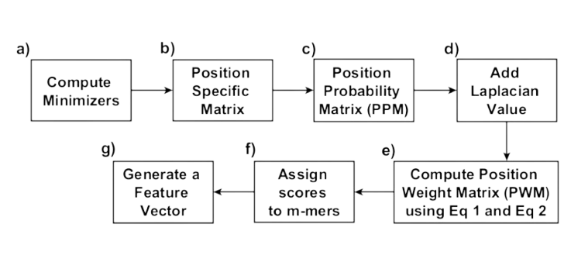
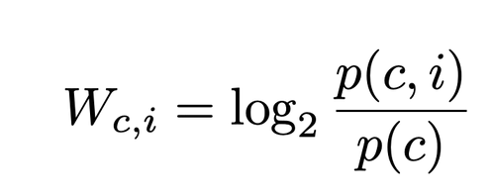
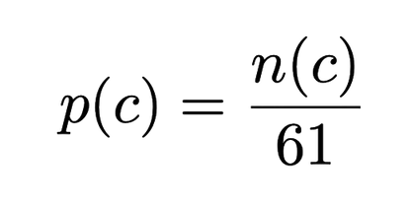
Virus2Vec
Break it into overlapping k-mers, then compute the minimizer
Position Frequency Matrix (PFM): Count the frequency of each AA at each position in the minimizer
Position Probability Matrix (PPM): Normalize (PFM) + Laplace smoothing to avoid zeros
Position Weight Matrix (PWM): Compute the log-likelihood of each AA at each position
Output: A feature vector with one score per minimizer.
Vector Size: |Σ| × m (amino acid alphabet × minimizer length).

Slide 17
Biological Features
APAAC: Amino Acid composition correlation based on hydrophobicity and hydrophilicity.
DDE: Deviation of dipeptide frequencies from the expected mean under amino acid independence.
CTriad: Group amino acids by similarity and encode overlapping triplets.
Geary Autocorrelation: Variation of amino acid properties across sequence positions.
CTDD: Encodes how amino acids with similar physicochemical properties are distributed along the sequence.

Slide 18
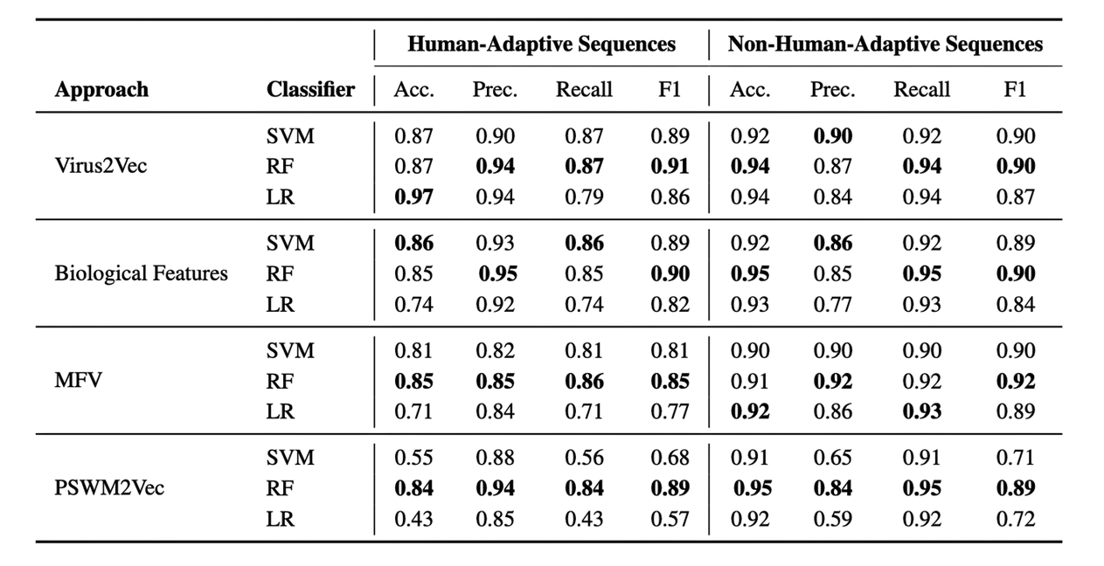
Results
Training dataset: 80,000 viruses from NCBI GenBank and GISAID, collected before 2023, with an 80:20 split for training and validation.
Test datasets: spanning 2023–2025, included 3,500 viruses from GISAID and NCBI, covering diverse viral families.
Best Classifiers :
Random Forest (n_estimators=100)
SVM (kernel = rbf, C= 1)

Slide 19
04
Virus Host Adaptability Predictor (DL)

Slide 20
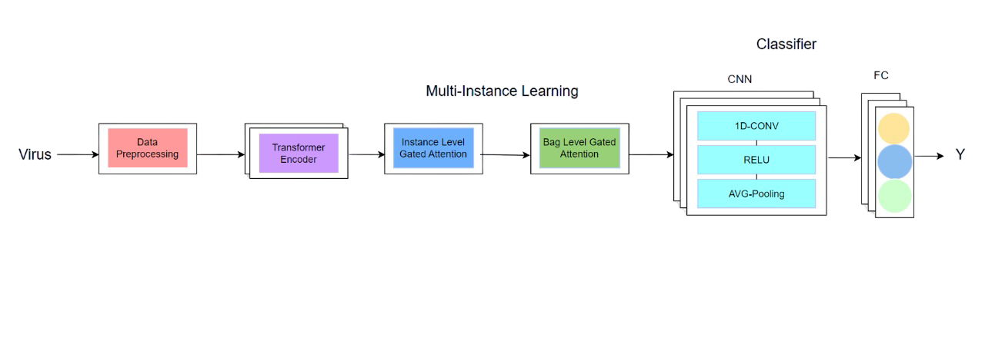
Block Diagram

Slide 21
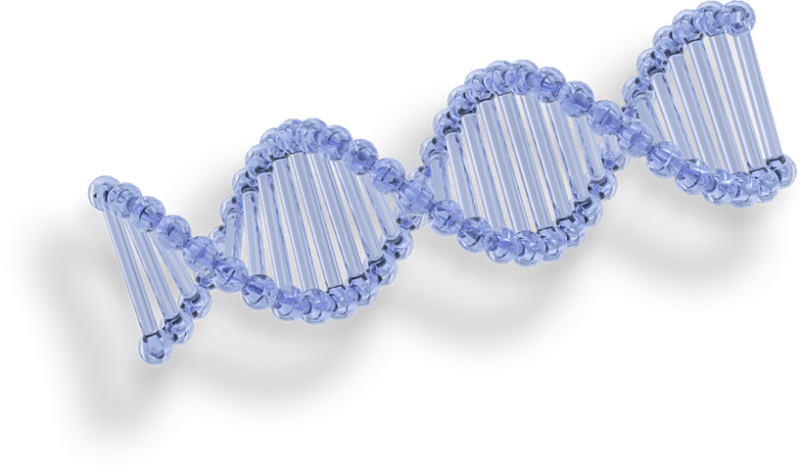
Data Preprocessing
Removing duplicate sequences
Removing highly similar sequences
Removing incomplete sequences
Removing ambiguous sequences

Slide 22
Virus Embedding : Custom Embeddings
Tokenized sequences using adaptive sliding window
Word2Vec vs FastText with CBOW : For initial embeddings
Two-layer encoder : To enhance the embeddings

Slide 23
Virus Embedding : ESM-b1
Transformer-Based protein language model
# Parameters > 400 Million
Fine-tuning was infeasible due to its high computational requirements and memory demands.

Slide 24
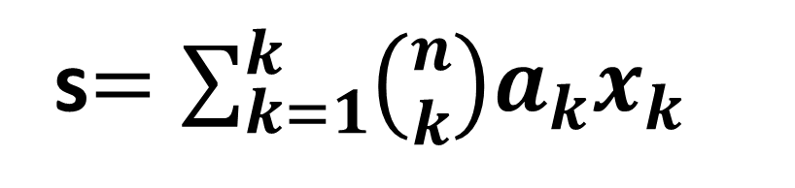
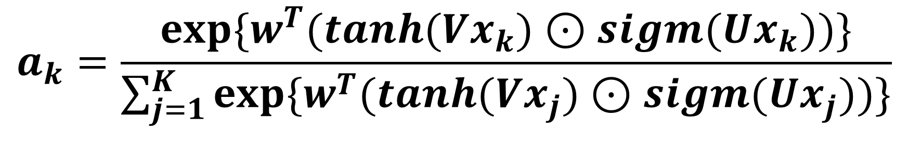
Attention Based Multi-Instance Learning
This stage has 2 steps to get one final embedding vector for each virus based on the attention mechanism:
Instance level : combine the sequence tokens’ embedding into one vector.
Bag level : combine the virus sequences’ embedding into one vector.
$$a_{k}=\frac{{exp⁡\{w}^{T}(tanh({Vx}_{k})⊙sigm({Ux}_{k}))\}}{\sum_{j=1}^{K}{{exp⁡\{w}^{T}(tanh({Vx}_{j})⊙sigm({Ux}_{j}))\}}}$$
s$=\sum_{k=1}^{k}{\left({n \atop k}\right)a_{k}x_{k}}$

Slide 25
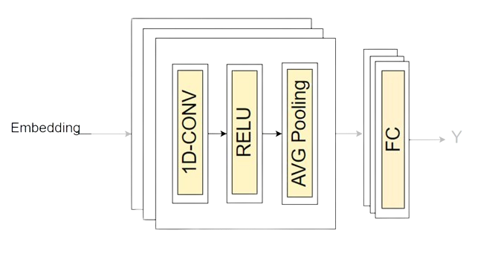

Classifier
embeddings
Y

Slide 26
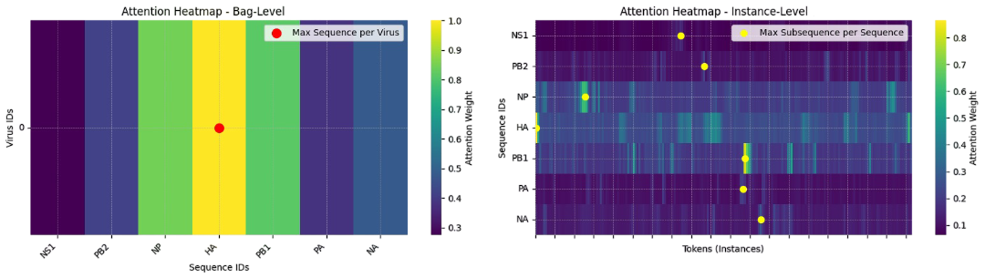
Attention Weights Explaining
To understand the importance of each token and sequence in the virus, we use attention weights.

Slide 27
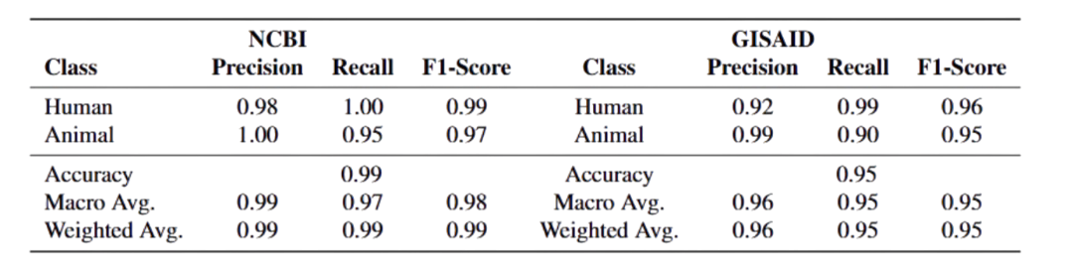
Results

Slide 28
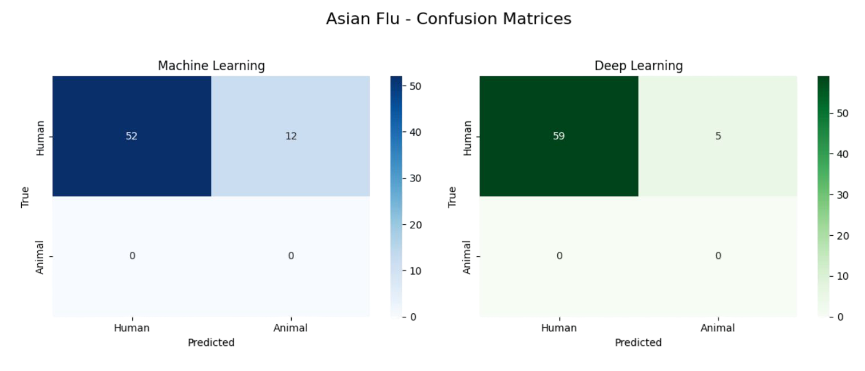
Results for Asian Flu
ViroAlert was tested on Asian Flu sequences from 1957 to 1958.

Slide 29
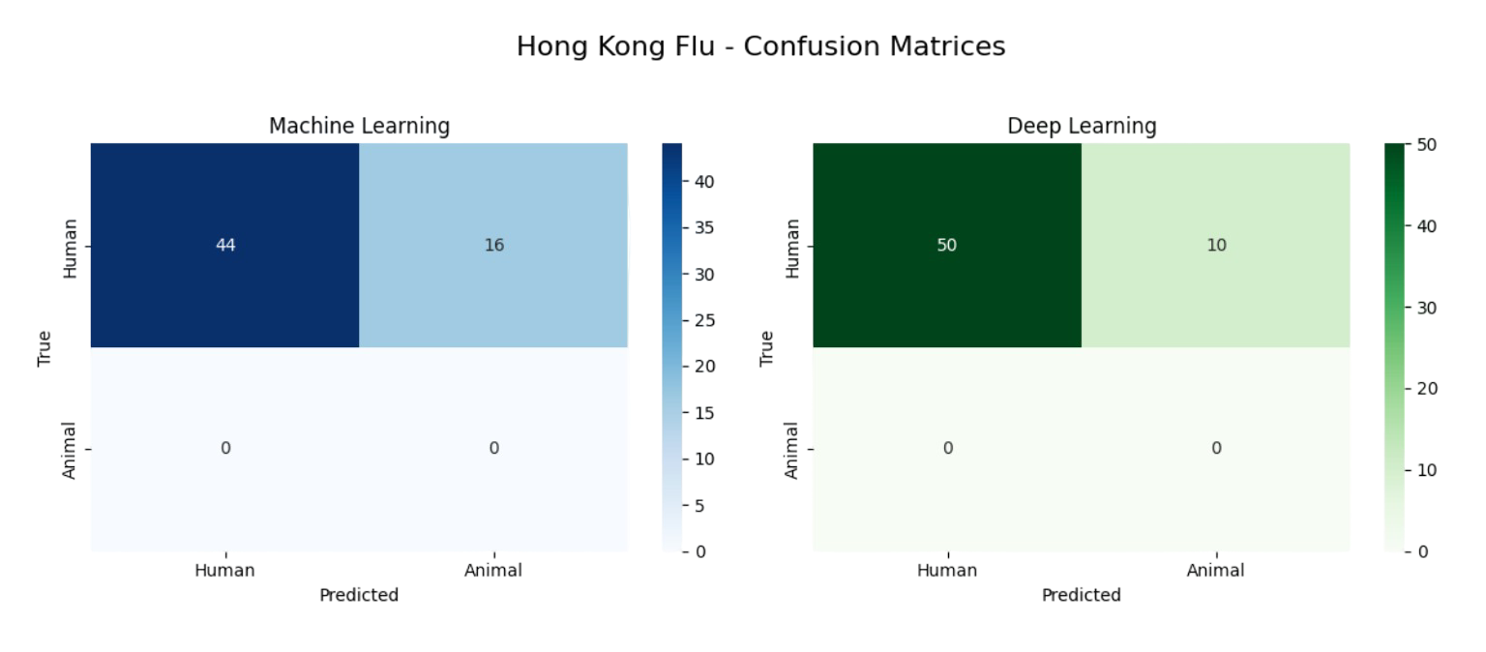
Results for Hong Kong Flu
ViroAlert was tested on Hong Kong flu sequences from 1968 to 1970.

Slide 30
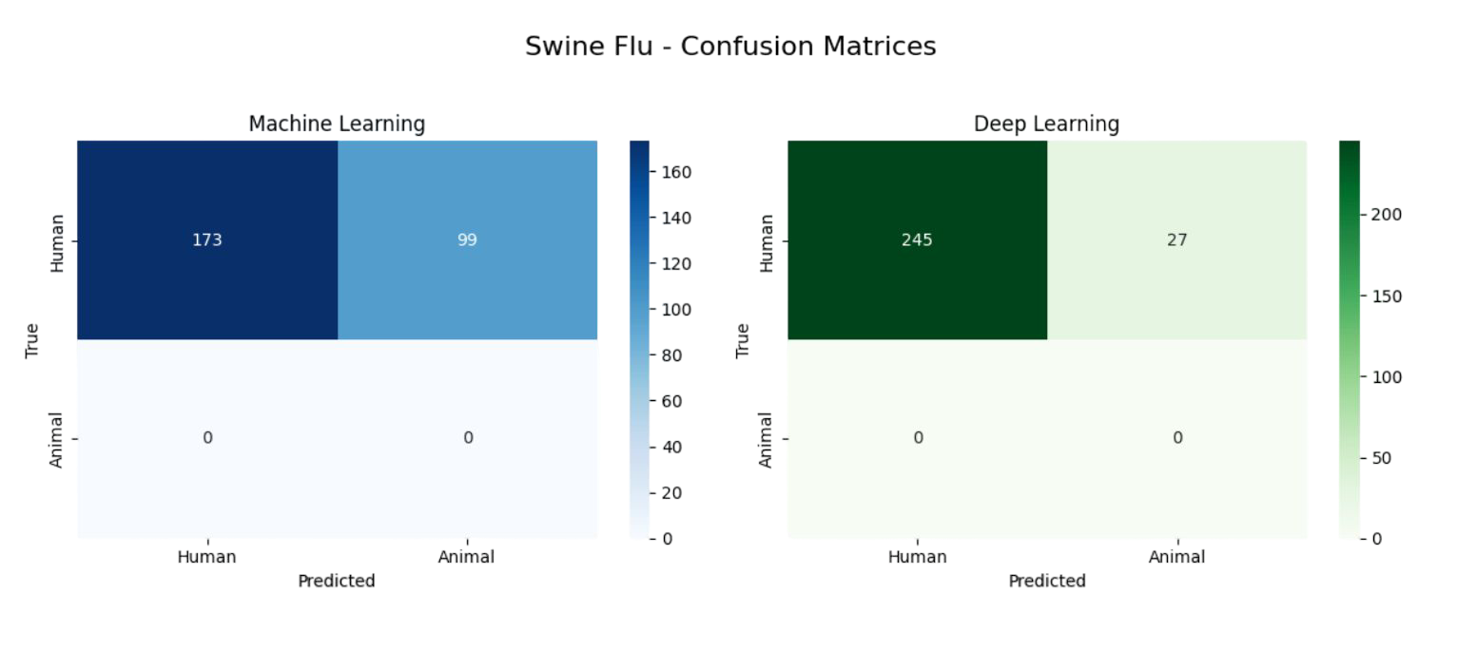
Results for Swine Flu
ViroAlert was tested on Swine Flu sequences from 2009 to 2010.

Slide 31
Results for Corona Virus
ViroAlert was tested on pre-2020 Corona Virus sequences from non-human hosts (e.g., bats).
85% were predicted as human-adapted.
ViroAlert can serve as a critical early-warning system for emerging pandemic threats.

Slide 32
05
Drug Target Interaction Predictor

Slide 33
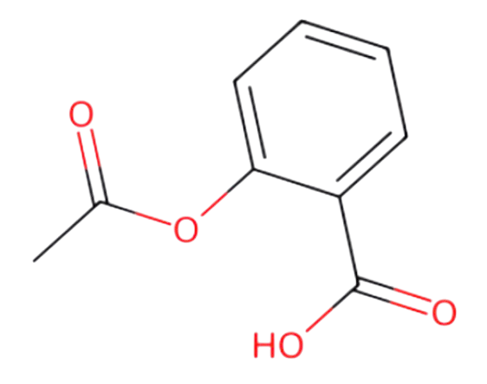
Drug Graph Construction
CC(=O)OC1=CC=CC=C1C(=O)O ---->

Slide 34
Drug Graph Construction
We convert the SMILES format of a drug into a graph structure where:
Nodes represent atoms
Edges represent chemical bonds
Each bond has a type (e.g., single, double, aromatic)
Edges are assigned weights based on bond type

Slide 35
pIC₅₀
pIC₅₀ is the negative logarithm of the IC₅₀ value.
IC₅₀ is the concentration of a drug needed to reduce a specific biological activity by 50%.
The higher the pIC₅₀, the stronger and more effective the drug is.

Slide 36
Dataset
Dataset Source:
The dataset used was obtained from the ChEMBL database.
Data Format:
Each record in the dataset contains:
Drug molecule represented as a SMILES string
Viral protein represented by its amino acid sequence
pIC₅₀ value
,

Slide 37
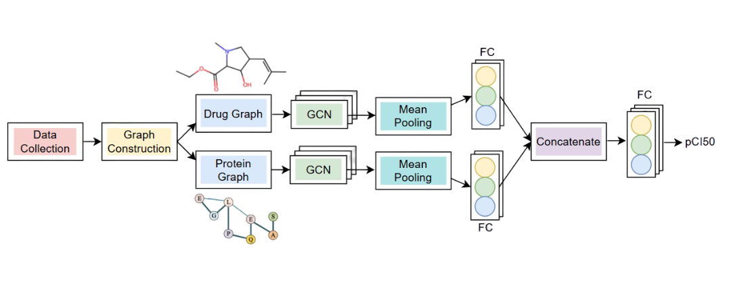
Block Diagram

Slide 38
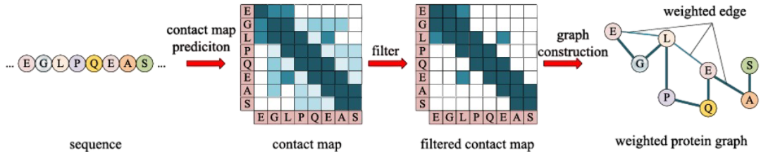
Virus Graph Construction
We use a pretrained protein language model (ESM) to generate a contact map, which predicts interaction probabilities between amino acids in the virus sequence. This contact map helps us build the protein graph.

Slide 39
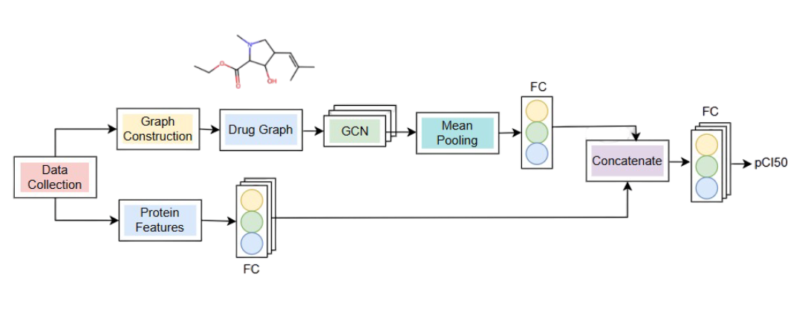
Block Diagram for First Trial

Slide 40
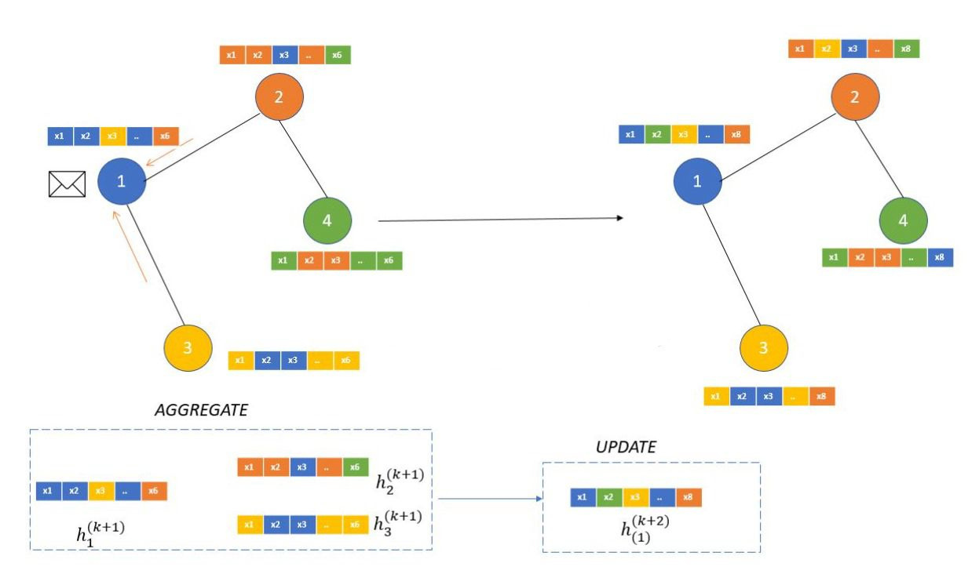
Graph Convolutional Network

Slide 41
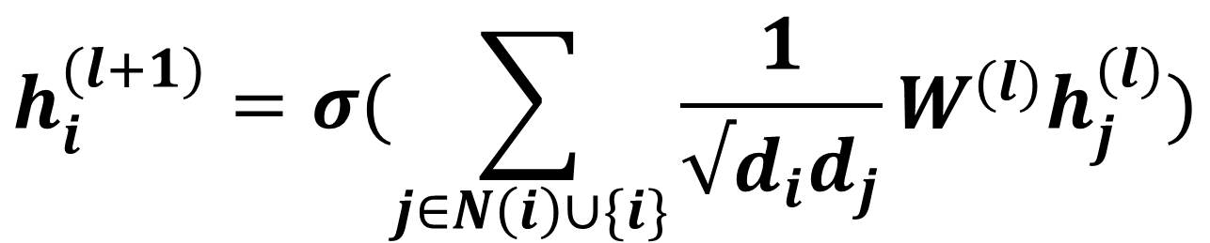
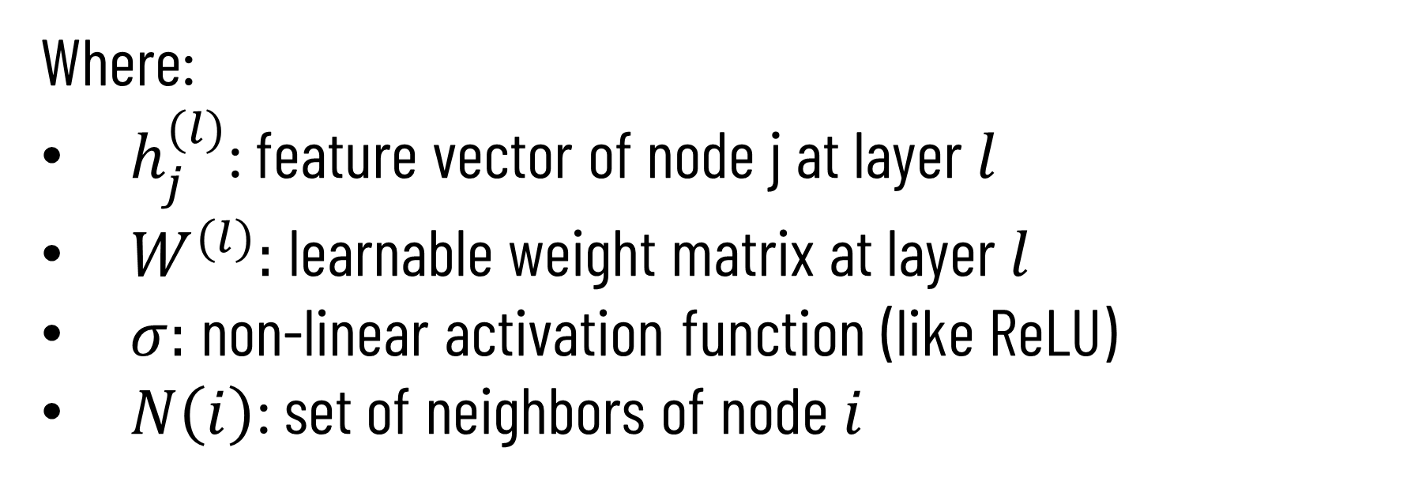
Graph Convolutional Network
The node feature update can be written as:
$$h_{i}^{(l+1)}=σ(\sum_{j∈N\left(i\right)∪\{i\}}{\frac{1}{√d_{i}d_{j}}W^{(l)}h_{j}^{(l)})}$$
Where:
$h_{j}^{(l)}$: feature vector of node j at layer 𝑙
$W^{(l)}:$ learnable weight matrix at layer 𝑙
$σ:$ non-linear activation function (like ReLU)
$N\left(i\right)$: set of neighbors of node 𝑖

Slide 42
Results
Our Drug Target Interaction model achieved the following performance metrics on the test data:
MSE: 0.9
Pearson Correlation Coefficient: 0.83

Slide 43
06
Drug Generator

Slide 44

GAN Pipleline
01
Pre-Training Stage
Main Training Stage
02
03
Fine Tuning Stage
04
Generating New Drugs

Slide 45
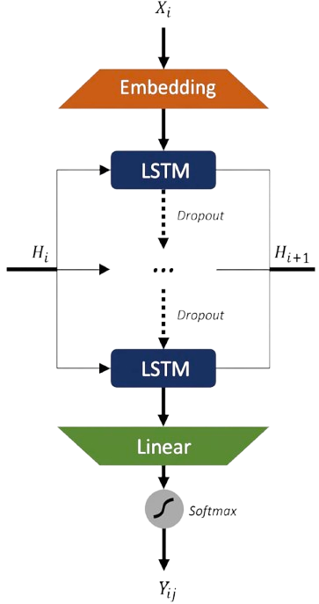
Generator
LSTM-based (4 layers, 256 hidden units per layer)
Outputs SMILES char-by-char (up to 128 tokens)
Temperature control for diversity (default 1.0)

Slide 46
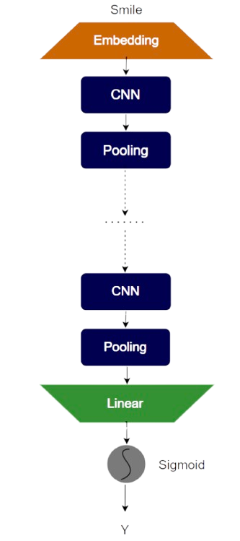
Discriminator
CNN model (2 convolutional layers)
Input: padded SMILES (128 tokens)
Output: real or generated (binary classification)

Slide 47
Pre-training stage
Establishes stable parameters for Generator and Discriminator
Uses MLE for Generator to learn SMILES distribution
Trains Discriminator as binary classifier on real vs. generated data
Prepares models for adversarial training

Slide 48
Reinforcement via Monte Carlo Rollouts
To train the Generator using RL, SMILES is generated as a step-by-step sequence prediction task.
Monte Carlo Sampling for Reward Estimation:
For each partial SMILES sequence, we use Monte Carlo rollouts to sample multiple complete SMILES.
Each completed sequence is evaluated using the Reward Function.

Slide 49
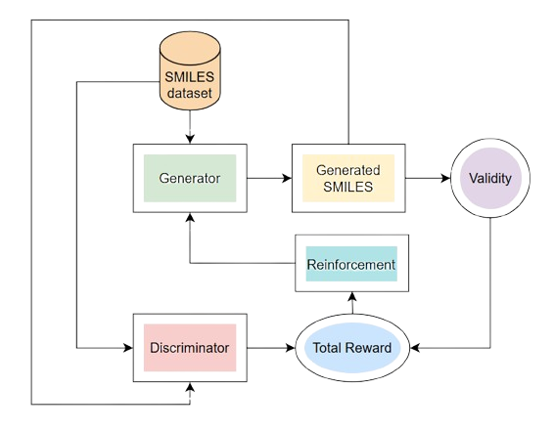
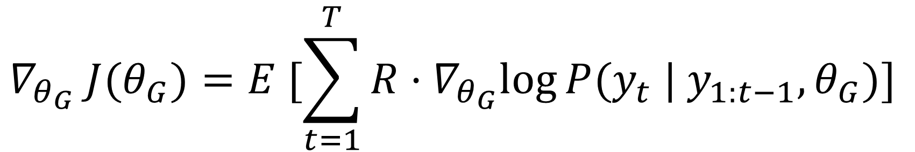
Main Training stage
Generator Reward depends on :
Validity
Discriminator Score
The expected reward is calculated as follows:
$$∇_{θ_{G}} J(θ_{G})=E [\sum_{t=1}^{T}{R·∇_{θ_{G}}log⁡P(y_{t} | y_{1:t−1}, θ_{G})}]$$

Slide 50
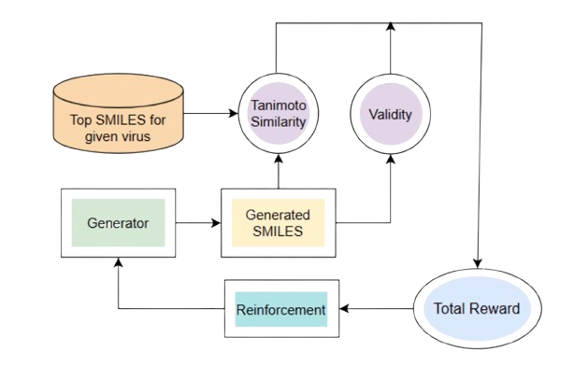
Fine Tuning stage
DTI model gets top-scoring known drugs.
Generator fine-tuned to generate similar ones using:
Validity
Tanimoto similarity as part of the reward

Slide 51
Results after Traning
The generator learns chemically valid and diverse molecules, but many are still generic or weakly active without fine-grained targeting.
We generated 10,000 drug and got the following results:
Valid SMILES: 9301 (93.01%)
Unique SMILES: 9270 (99.66%)
Novelty: 98.78%

Slide 52
Results after Fine Tuning
We fine-tuned the model using protein graph data from Influenza A.
SMILES | PIC50
CCC(CC)OC1C=C(CC(C1NC(=O)C)N)C(=O)OCC Oseltamivir | 8.58
CCOC(=O)C1=C(C)NC(=O)C2C=C(C)CC2C1 | 7.8

Slide 53
07
Demo

Slide 54
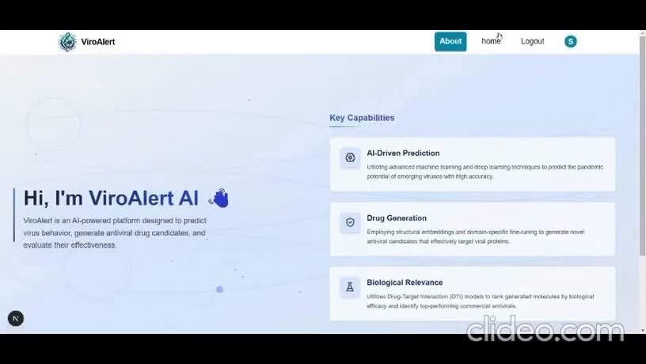

Slide 55




